Slide 1
AWS cloud solution for AspireClothes e-commerce
March 2021

Slide 2
Proposed by:
Group 4 team members
Abiola Abiodun
Sameh Mostafa
Faisal Ali
Abdul Baig

Slide 3
Problem statement
AspireClothes, a start-up company that sells clothes needs to build an e-commerce website, but they have a very small budget. The CEO of the company has some web development skills and wants to build the website herself. Come up with a solution for the CEO to use AWS to build her own website, and deploy it so it is accessible internationally, and how she can utilise the system to reduce the cost. The latency in which the app loads must be as low as possible. Explain which Amazon services could be used to protect the company from a DDoS attack. The e-commerce website must be globally available. Also account for methods in which the company’s AWS architecture would allow for integration with other companies in the supply chain. The CEO also wishes to have real-time analytics of the users who interact with the e-commerce sight so that she can give customised and targeted messaging to drive higher sales.

Slide 4
Contents
Key requirements
AWS technologies to consider
Introduction
Serverless systems
Low level architecture
High level architecture
Cost estimate
Conclusion
Reference

Slide 5
Key requirements from the CEO
Global & high availability, scalable, low latency and cost-effective.
Solution to combat cybersecurity, integration with supply chain (likely automated).
Real-time analytics of users, customers traffics, and messaging channel.

Slide 6
Other requirements of digital commerce ecosystem
Customer experience:
Storefront
Mobile
Shopping cart
Community
Marketplace
Enabling technology:
Product catalog
Product content management
Analytics
Integration:
Order management
ERP
CRM
Payment gateway
Customer service
Fulfilment

Slide 7










AWS technologies to consider for this task
AWS Cloud
Compute
Amazon Cognito
AWS Shield
AWS Identity and Access Management (IAM)
AWS Lambda
Security
Compute
Global and scalability
AWS cloud is secure and give scalable infrastructure
Cognito, shield and IAM will be consideredd for security in addition to deploying the database in a VPC
Lambda will be considered for serverless computation
Database / Storage
Amazon QuickSight
Amazon Simple Notification Service (Amazon SNS)
Amazon Simple Email Service (Amazon SES)
Amazon DynamoDB
Amazon Aurora Serverless
S3 Bucket
Analytics and visualization
Amazon QuickSight or Athena
Aurora serverless
Communication and marketing

Slide 8
Introduction
E-commerce stores has fluctuating web traffic, depending on seasonal and marketing promotions like black-Friday.
To cut cost, modern e-commerce stores are deployed in cloud environments which permit scaling up and down, depending on the expected traffic.
In this way organizations only pay for what they use, and always provide their users/customers with the right experience.

Slide 9
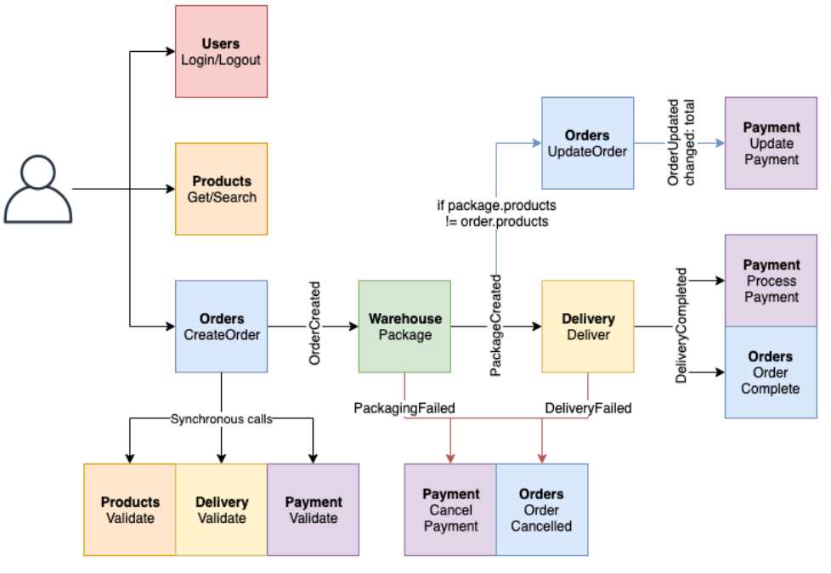
Flow chart of e-commerce interaction
Typical e-commerce store interactions and transaction is presented in a flowchart illustrated in Figure1showing the different operation by users and operators.

Slide 10
Scalable serverless e-commerce website with 0% commitment
Amazon Web Services offers e-commerce cloud computing solutions to small and large businesses that want a flexible, secured, highly scalable, and low-cost solution for online sales and retailing [1]. We will build a real-time use case of AWS serverless solution for AspireClothes. This solution will meet the following requirements:
High availability, scalable, low latency and highly secured
Products listings, details, and carting.
Customer’s ratings and communication
Supply chain channels
Payments and delivery channel
Create account and login pages
Real-time analytics of traffics.

Slide 11


Serverless
Serverless is a way to describe the services that enable you to build and run applications without thinking about servers. AWS has serverless services for all layers of your stack.
When it comes to building an architecture diagram, it’s more intuitive to use a functional categorization. Please find the architecture icon for each serverless service in its functional category.
Compute
Containers
Application Integration
Storage
Database
AWS Lambda
AWS Fargate
Amazon SQS
Amazon SNS
Amazon EventBridge
AWS Step Functions
AWS AppSync
Amazon S3
Amazon DynamoDB
Amazon RDS Proxy
Amazon Aurora Serverless

Slide 12
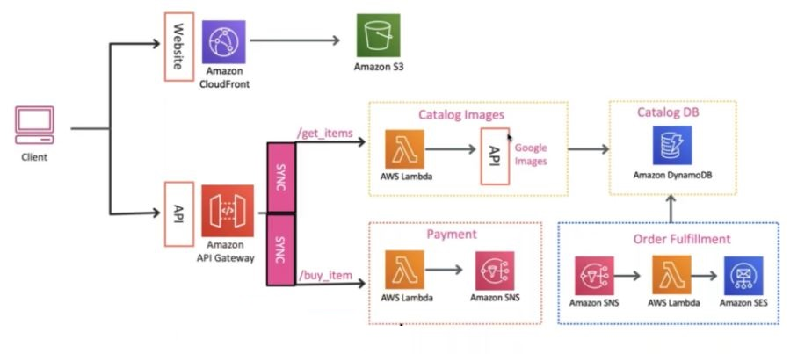
Low level architecture
Find below a summarise schematic of a low-level architecture. We are using serverless-based systems because it’s cheaper.

Slide 13
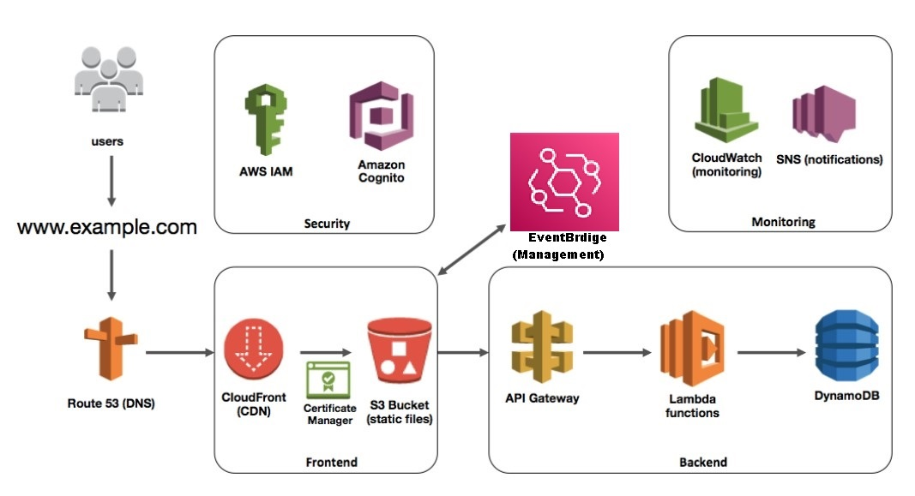
Component interactions

Slide 14
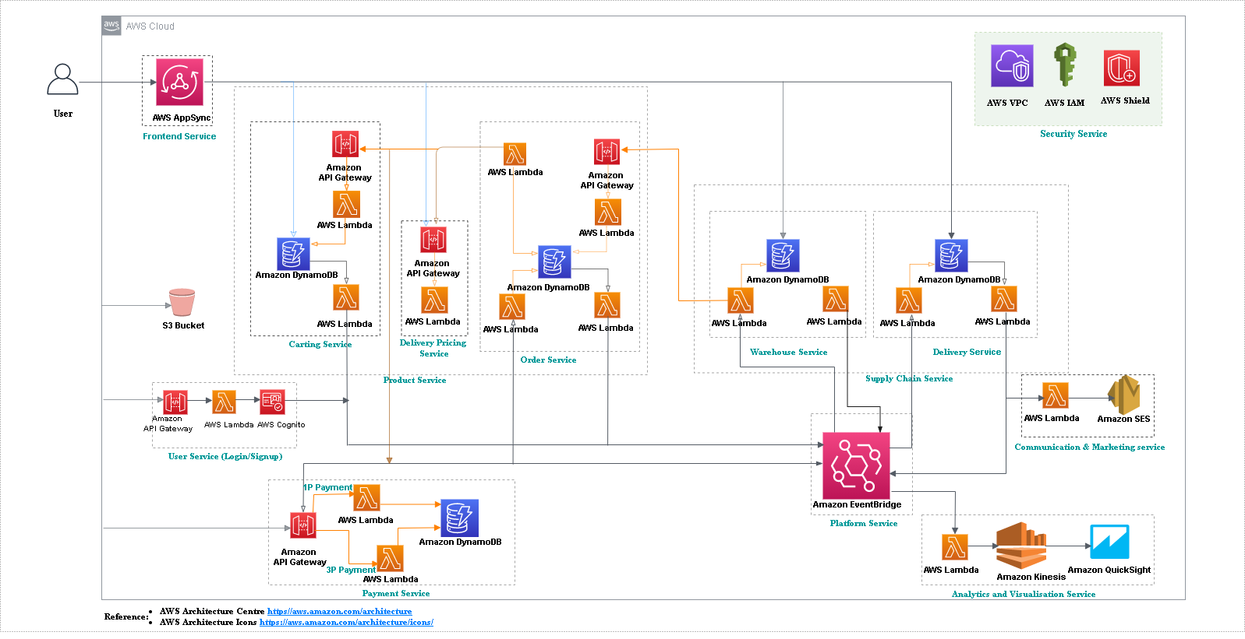
High level architecture

Slide 15
Cost estimate
For our pricing example, we will assume that AspireClothes online store will receive the following traffic per month: 100,000-page views, 1000 registered user account, 200GB data transferred considering an average page size of 2MB. 5,000,000-code executions (Lambda functions) with an average of 200 milliseconds per request.
For our case study, some services are free (AppSync, IAM, SNS, certificate manager) others varies or are fixed, charged hourly or monthly.
The total cost of running our our e-commerce model on AWS for a month will be $125 to $150

Slide 16
Pre-requisite for running this e-commerce model
A staff with basic computer skills (administrator)
AWS command line interface (CLI) or console
AWS serverless application model (AWS SAM)
An AWS Account with permissions to create: AWS Identity and Access Management (AWS IAM) roles, AWS Simple Storage Service (Amazon S3) buckets, Amazon DynamoDB tables, and AWS Lambda functions, AppSync, EventBridge and others.

Slide 17
Conclusion
AspireClothes required a cost-effective AWS architectural plan to migrate their e-commerce store to the cloud. After quick review of the CEO demands and other basic requirements, a low level-architecture was used to illustrate the services needed and their interactions. After a thorough analysis of cost with respect to AWS best practices, a high-level architecture was generated and illustrated in figure 4. A cost estimate for the first month of deployment was further established and the key of administrators needed to manage the service.

Slide 18
Reference
AWS, Ecommerce Cloud Hosting - Ecommerce Applications. Accessed 16 March 2021[online]. Available: https://aws.amazon.com//ecommerce-applications/
AWS Pricing calculator. Accessed 12 March 2021[online]. Available: https://calculator.aws/#/
AWS architecture icons. Accessed 13 March 2021[online]. Available on https://aws.amazon.com/architecture/icons/
Seongtaek Oh, AWS architecture e-commerce, Slideshare, May 19, 2016. Accessed 12 March 2021[online]. Available: https://www.slideshare.net/SEONGTAEKOH1/awsarchitectureecommerce
Savia Lobo, a serverless online store on AWS could save you money, Packtpub hub, June 14, 2018. Accessed on 14, March 2021[online]. Available on: https://hub.packtpub.com/a-serverless-online-store-on-aws-could-save-you-money-build-one/
AWS serverless e-commerce platform, AWS github repository. Accessed 14 March 2021[online]. Available: https://github.com/aws-samples/aws-serverless-ecommerce-platform#technologies-used

Slide 19
Thank You!
Group 4

